Slide 1
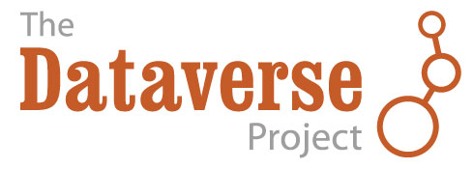
Sharing Your Data with Dataverse
Elizabeth Quigley
User Experience Lead
The Dataverse Project (@dataverseorg)
equigley@iq.harvard.edu

Slide 2
What is Dataverse?
A software framework for publishing, citing and preserving research data (open source on github for others to install)
Developed by the Institute for Quantitative Social Science at Harvard University.
Provides incentives for researchers to share:
Recognition & credit via data citations
Control over data & branding
Fulfill Data Management Plan requirements

Slide 3
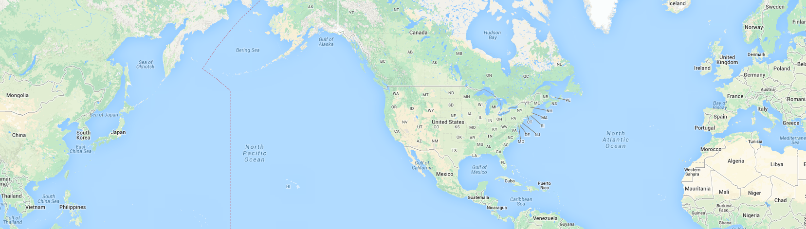
The Dataverse Community
Institutions can setup/host their own Dataverse repository (UNC ODUM, Fudan Univ, Scholars Portal, DANS, etc) and within them can have dataverses for a variety of users (across all research domains): Researchers, Projects, Journals, etc.

Slide 4
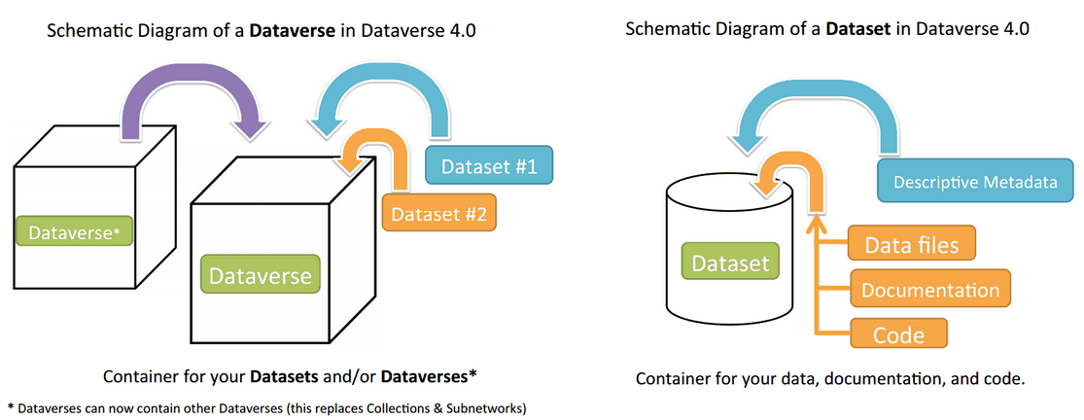
What is a Dataverse or Dataset?

Slide 5
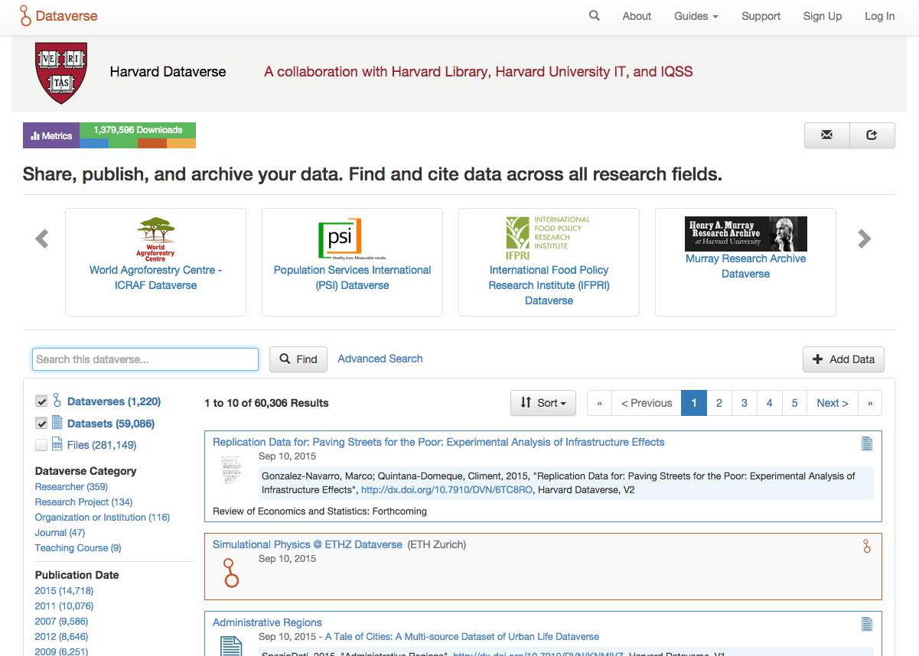
dataverse.harvard.edu

Slide 6
Harvard Dataverse
Open to all repository instance at Harvard currently has:
1,298
Dataverses
59, 370
Datasets
> 1.4 Million Downloads
284, 473
Files
*number from October 25, 2015

Slide 7
DATAVERSE BEST PRACTICES

Slide 8
Dataverse Best Practices (1)
Standard Metadata Schemas
  DDI & OAI DC
  New in 4.0:
    DataCite 3.1
    ISA-Tab (biomedical)
    VO Resource (astronomy)
    DC Terms
  Metadata can be exported in JSON & XML

Slide 9
Dataverse Best Practices (2)
Metadata is always public once a dataset is published
By default, datasets receive CC0 Waiver
Even though default is CCO and we encourage open/public data, when needed, data files in a dataset can be made restricted, or terms of use can be added

Slide 10
Dataverse Best Practices (3)
Formal Data Citation
  Originally based off Altman + King 2007
  Endorse + comply w/ 2014 Joint Declaration of Data Citation Principles (FORCE11)
    Lead by Merce Crosas, Director of Data Science @ IQSS
  Versioning and File Fixity
Persistent IDs: DOI (DataCite/EZID)
  Resolve to a dataset landing page, not directly to the data files
Notes:
Merce Crosas leads FORCE 11 Citation Principles Group

Slide 11
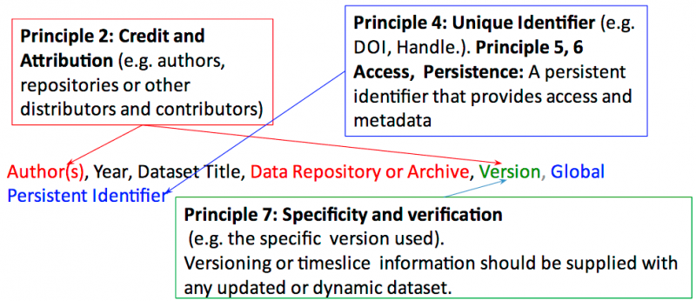
Data Citation Example
Notes:
DOI (persisten urls) resolve to a landing page, not directly to the data files. The landing page gives information about the dataset which is important to reuse the dataset.
- Citation metadata in a human and machine readable format (in our case, it's compliant with DataCite citation metadata)
- versioning is part of the citation

Slide 12
Dataverse Best Practices (4)
Preservation format conversion for tabular data (extract column/variable metadata)
File Fixity:
  UNF (Altman, 2008) for tabular data
  MD5 checksums for other files
Notes:
File Fixity is a digital preservation term referring to the property of a digital file being fixed, or unchanged.^{[1]} Fixity checking is the process of verifying that a digital object has not been altered or corrupted

Slide 13
Dataverse Best Practices (5)
Data-PASS: (ICPSR, ODUM, NARA, ROPER,…)
  Member of Data-PASS
OAI-PMH: Harvesting metadata (DC, DDI)
  From other Dataverse installations
  From other OAI-DC compliant repositories
If necessary: Deaccession a Dataset
Notes:
Merce is member of steering committee for Data-PASS
The Data Preservation Alliance for the Social Sciences (Data-PASS) is a voluntary partnership of organizations created to archive, catalog and preserve data used for social science research. Examples of social science data include: opinion polls; voting records; surveys on family growth and income; social network data; government statistics and indices; and GIS data measuring human activity.
Still in process of adding OAI into 4.0

Slide 14
DISCOVERING + PUBLISHING DATA WITH DATAVERSE

Slide 15
Benefits for Researchers Using Dataverse
Add your own custom branding and increase your datasets’ visibility by embedding them on your website with our widgets.
Safe and long-term data storage in preservation format.
Share your data with everyone, or only specific individuals you approve.
No need to translate data when statistical software formats change.
Domain specific metadata: making it easy for others to find your data and associated scholarship.
Allow users to download your data in any format and run many advanced statistical methods online.

Slide 16
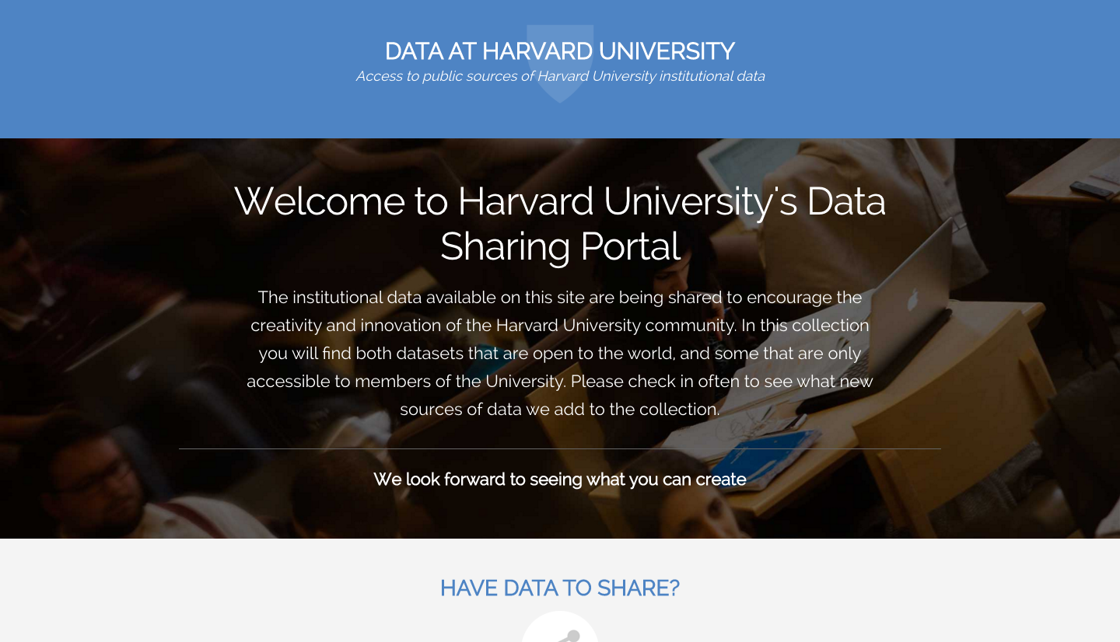
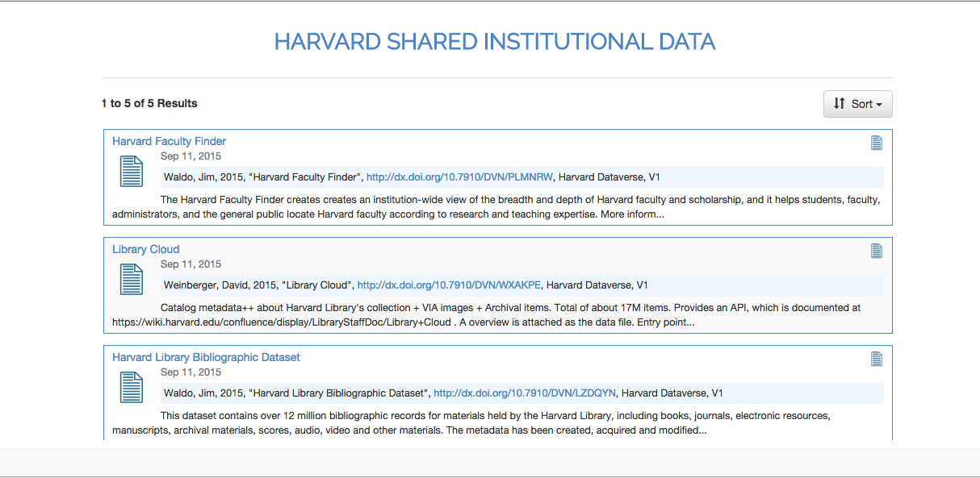

Slide 17
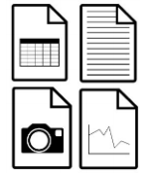
Rigorous Data Publishing Workflows
Upload
Draft
Dataset
Major + Minor Versioning
Published
Dataset v1
Publish Version 1
Authors, Title, Year, DOI, Repository, V1
Publish Version 1.1: small metadata change; citation doesn’t change.
Published
Dataset
v1.1
Publish Version 2: File change (automatic); big metadata change (e.g., author, title).
Published
Dataset v2
Authors, Title, Year, DOI, Repository, UNF, V2
Notes:
Compliant w/ Joint Declaration of Data Citation Principles and based on the paper by Altman and King, 2007 were pushing for machine readable information to be added to data citations (UNF, persistent identifier). Principle #7 Specificity & Verifiability Data citations should facilitate identification of, access to, and verification of the specific data that support a claim. Citations or citation metadata should include information about provenance and fixity sufficient to facilitate verfiying that the specific timeslice, version and/or granular portion of data retrieved subsequently is the same as was originally cited

Slide 18
LIVE DEMO TIME! demo.dataverse.org

Slide 19
ORGANIZING AN INSTITUTION’S DATA

Slide 20
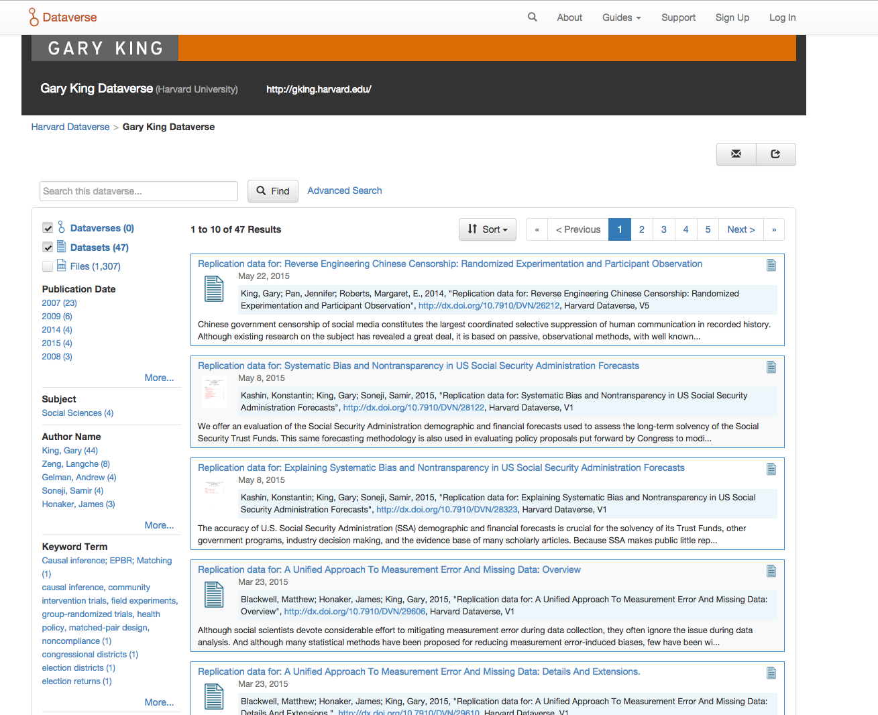
Researcher/Faculty Member
Gary King Example
Gary King Dataverse

Slide 21
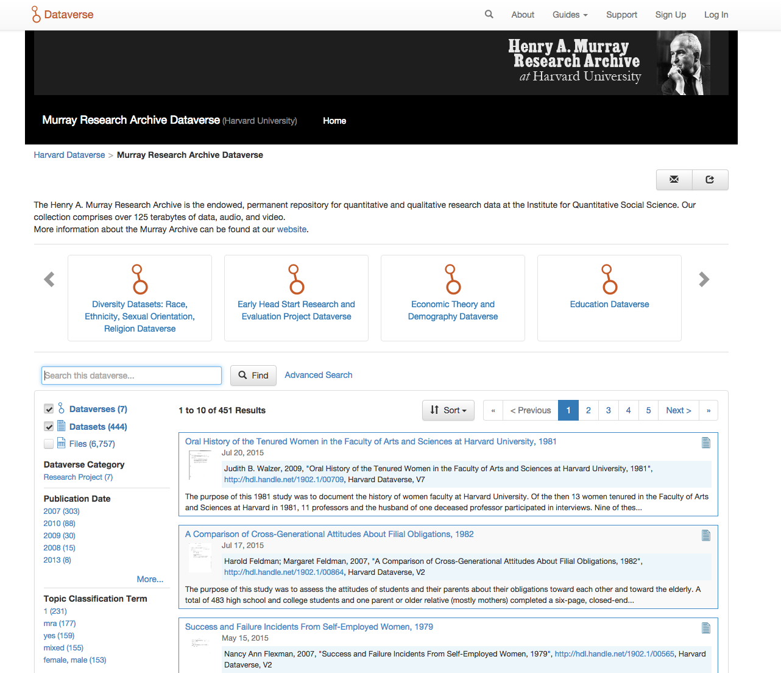
Research Project/Archive
Henry A. Murray Research Archive

Slide 22
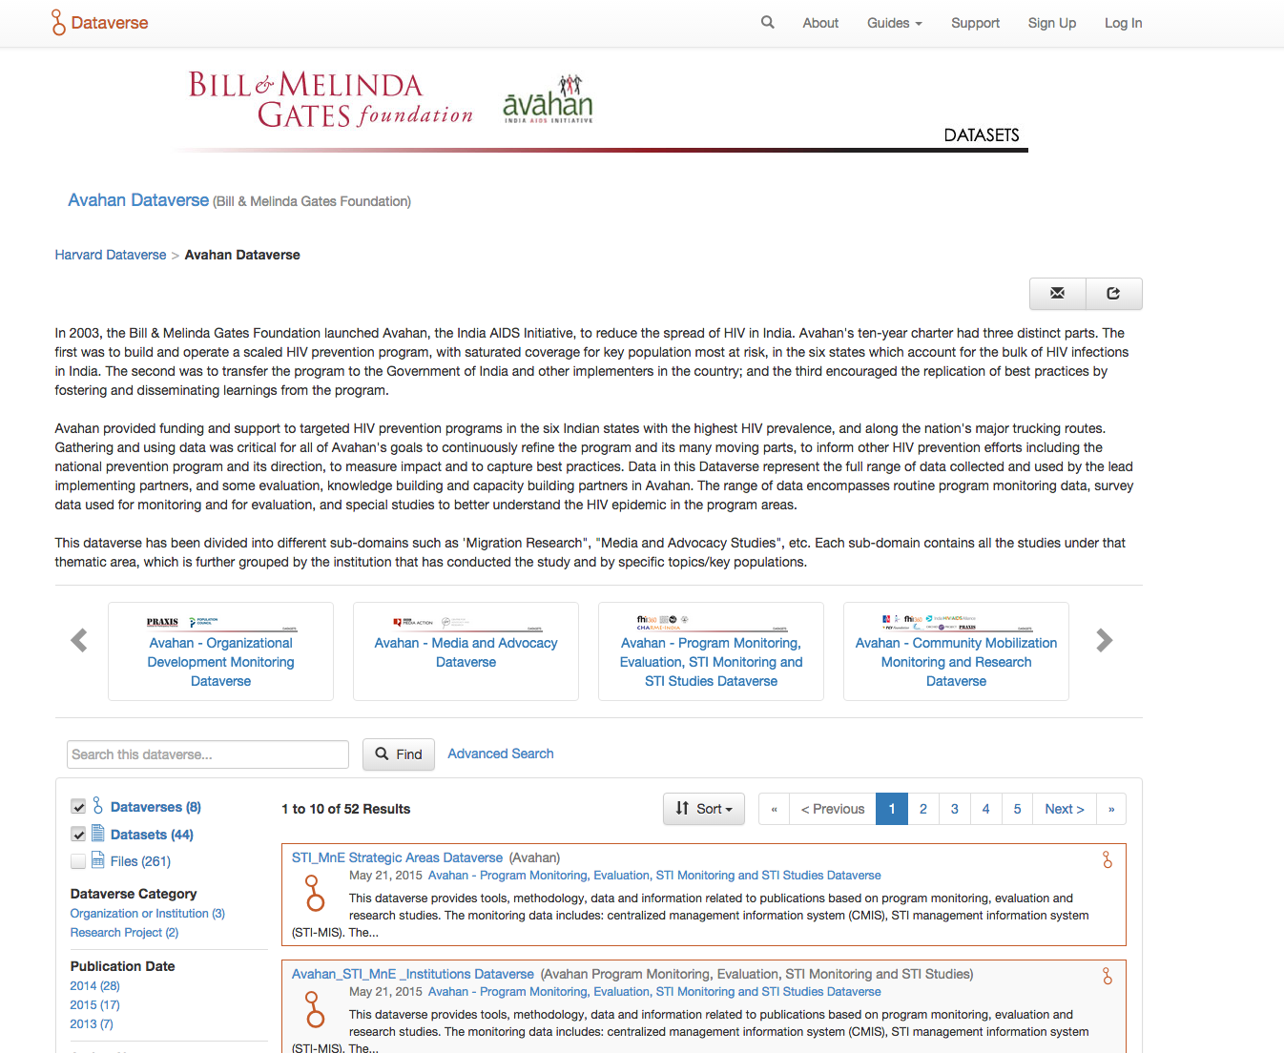
Organization or Institution
Avahan Dataverse

Slide 23
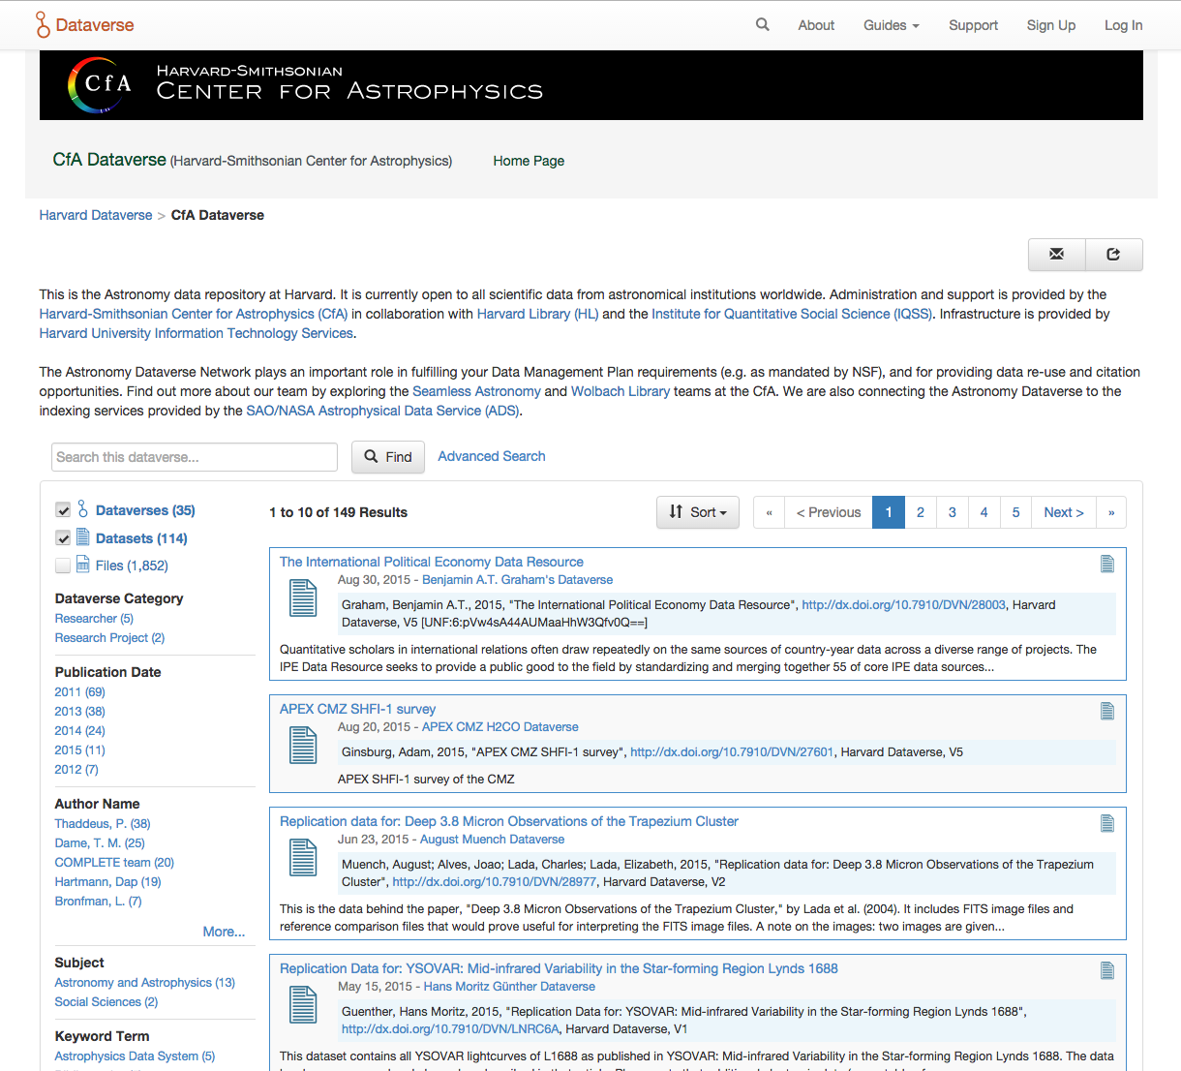
Department
Harvard-Smithsonian Center for Astrophysics

Slide 24
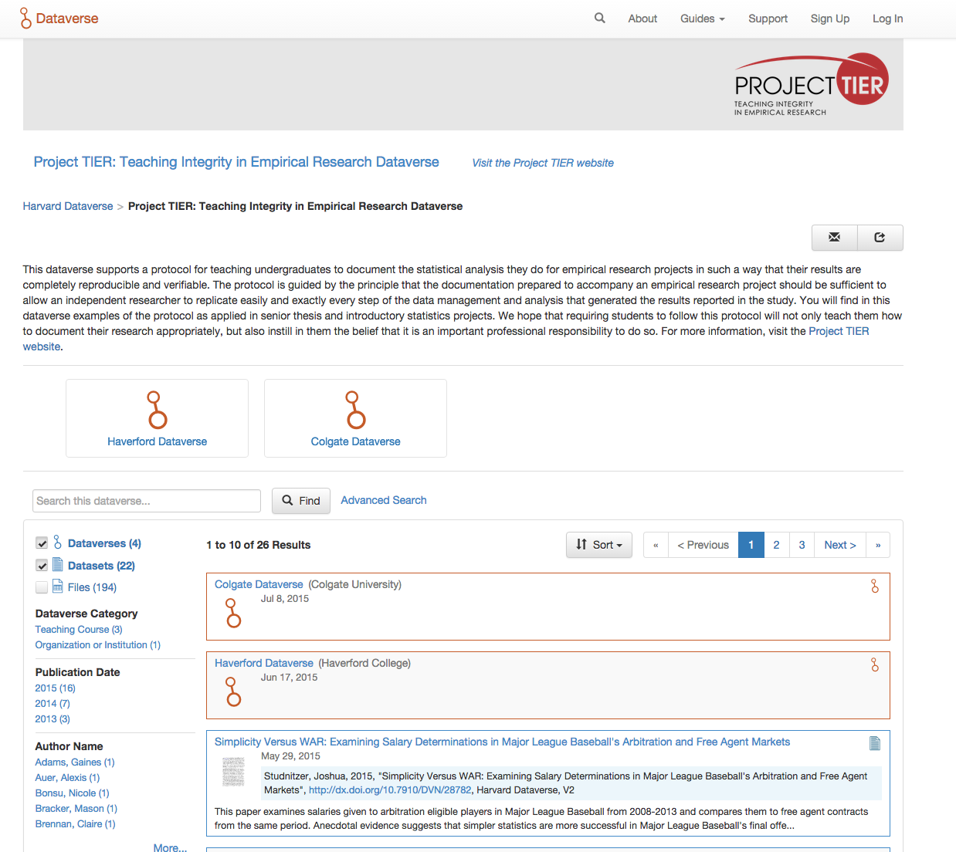
Courses
Project TIER

Slide 25

Thank you!
Any questions?
Contact: equigley@iq.harvard.edu
Learn more: dataverse.org
Try out Dataverse: demo.dataverse.org
@dataverseorg
References
Altman M. A Fingerprint Method for Verification of Scientific Data. In A Fingerprint
Method for Verification of Scientific Data. Springer-Verlag; 2008.
Altman M, King G. A Proposed Standard for the Scholarly Citation of Quantitative Data.
D-Lib Magazine [Internet]. 2007;13(3/4).

