Slide 1
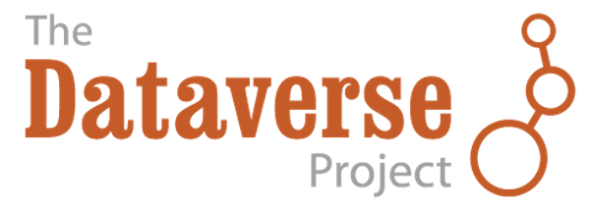
Community & Future Work
Elizabeth Quigley
User Experience Lead

Slide 2
The Dataverse Community
Dataverse Community Meeting
Universities Using Harvard Dataverse
Community & Working Groups
Code & Issue Contributors
Dataverse Installations
Dataverse Advisory Board
Biweekly Community Calls
Grant Funded Collaborations

Slide 3
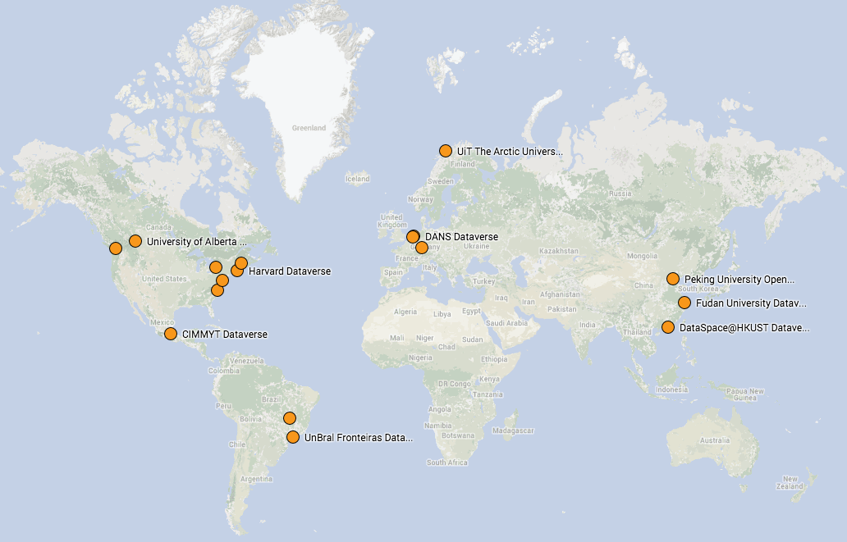
Dataverse Installations
Scholars Portal:
Archivematica Integration
Internationalization
Peking University:
Custom homepage
Internationalization
EZID Support
Harvard:
Core Development Team
Support Team
Birthplace of Dataverse
Odum Institute at UNC:
iRods Integration

Slide 4

Dataverse Installations

Slide 5



Future Work
Upcoming Releases:
Sensitive Data Support:
File Level Metadata:
4.4: Widgets Updates & Remote Authentication
4.5: Metadata Harvesting & Exporting, Private URL
Provenance
Richer support for file level metadata
Secure Data Storage for Harvard Dataverse (hosting set up)
DataTags compliant version of Dataverse
Large Data Support:
Funding Agencies
Streaming social sciences data, e.g.-billions of GeoTweets
Biomedical large scale data (SBGrid Repository)
Notes:
Add logos: NSF (sensitive and provenance data), Helmsley (large data), Sloan (file level metadata, large data support)
upload data through options besides http; retains data file structure

Slide 6
Welcome to the Dataverse Community!

